Slide 1
Default prediction model
Bene
Shinan

Slide 2
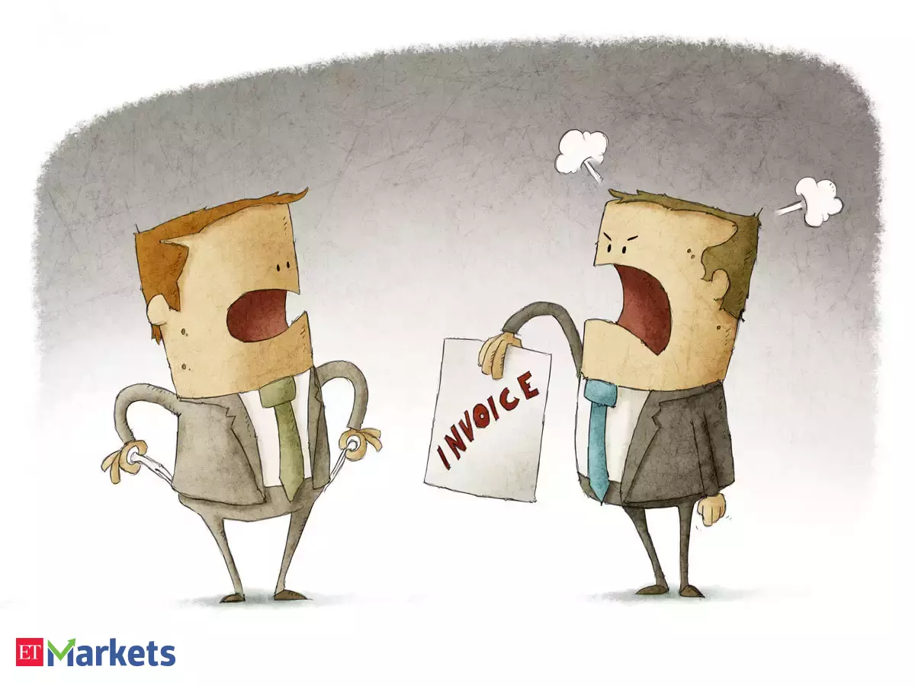
Default Risk
A lender takes on a risk that a borrower will not be able to repay the borrowed money.
Examples:
1 Purchase products: the client is not able to pay, so the company takes the default risk.
2. House Loan: the borrower is not able to repay the borrowed loan, the financial institution takes the default risk.
3. Company / Country issue bonds: The companies or countries issued bonds for raising cash, but not able to pay back, so the investors who bought the bonds bear the default risk.

Slide 3
Greece debt default and Goldman Sachs
Investment Bank Goldman Sachs made millions by helping to hide the true extent of the debt:
Back to 2001, Greece was not eligible to join Eurozone with its current financial situation (generally speaking debt ratio has to below certain level), so Greece was looking for ways to disguise its mounting financial troubles. Then Goldman Sachs came to the rescue, arranging a secret loan of 2.8 billion euros for Greece, disguised as an off-the-books “cross-currency swap. As a result, ‘reduced’ 2% of the total debt.
What did Goldman Sachs gain?
Service Fee 600 million euros ($793 million)
Transferred its default risk (loss of investment in Greece) to a German Bank by buying Credit Default SWAP (CDS).
Bought cheap CDS at lower price before Greece default, after Greece defaulted, it sold this CDS product at higher price to the investors who also invested into Greece. This leads to a even worser borrowing condition for Greece.
CDS buy : will be protected when the default happens
CDS Sell : will cover the loss of investment from the default risk

Slide 4

How to predict the default of a borrower? How to predict the default of a borrower?
Loan Risk Factors Dataset
Prediction
Expectations
Age | +
Income | +
Home ownership | +
Employment length | +
Loan intent | Depends
Rating | +
Loan Amount | -
Interest Rate | -
Debt to Income | -
Credit history length | +
Payment Delays | -

Slide 5
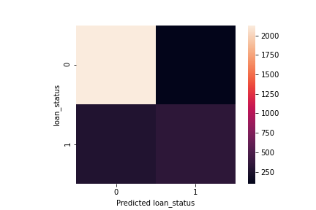
How to predict the default of a borrower? Prediction based on Logisitc Regression
TP: 96%
TN: 55%
Accuracy: 86%

Slide 6
How to predict the default of a borrower? Who will default?
 | Christina | Filipa
Age | 30 | 29
Income | 65,000 | 55,000
Home ownership | Rent | Owner
Employment length | 1 year | > 1 year
Loan intent | Venture | Home improvement
Amount | 35,000 | 15,000
Interest rate | 3.95% | 2.75%
Debt to income | 53% | 27%
Payment delays | Yes | No
Credit history length | 3 years | 1 year
Rating | B | C

Slide 7
How to predict the default of a borrower? Default Prediction
Christina & Filipa
Model
Ranking | Risk coefficients importance
1. | Loan amount | +
… | Income | (-)
Christina: Yes Filipa: No

Slide 8
How to predict the default of a borrower? Further Development
Analyze data according to demographics and adapt model
Handling imbalanced dataset (default feature)
Using machine learning approaches

Slide 9
Thank you

